Slide 1

Forests 2020:
Cloud Masking
Presented by
IPB

Slide 2
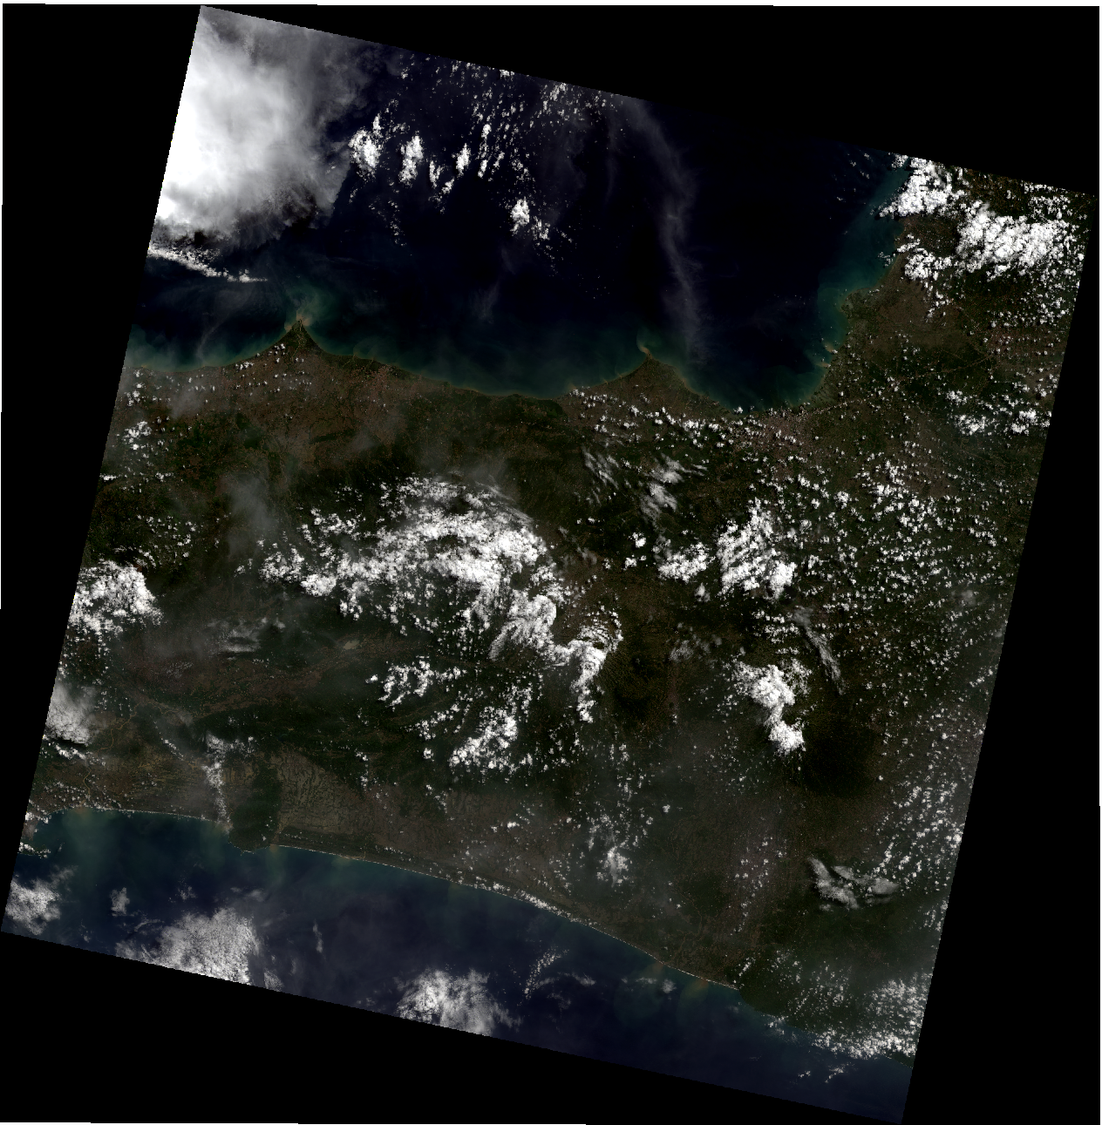
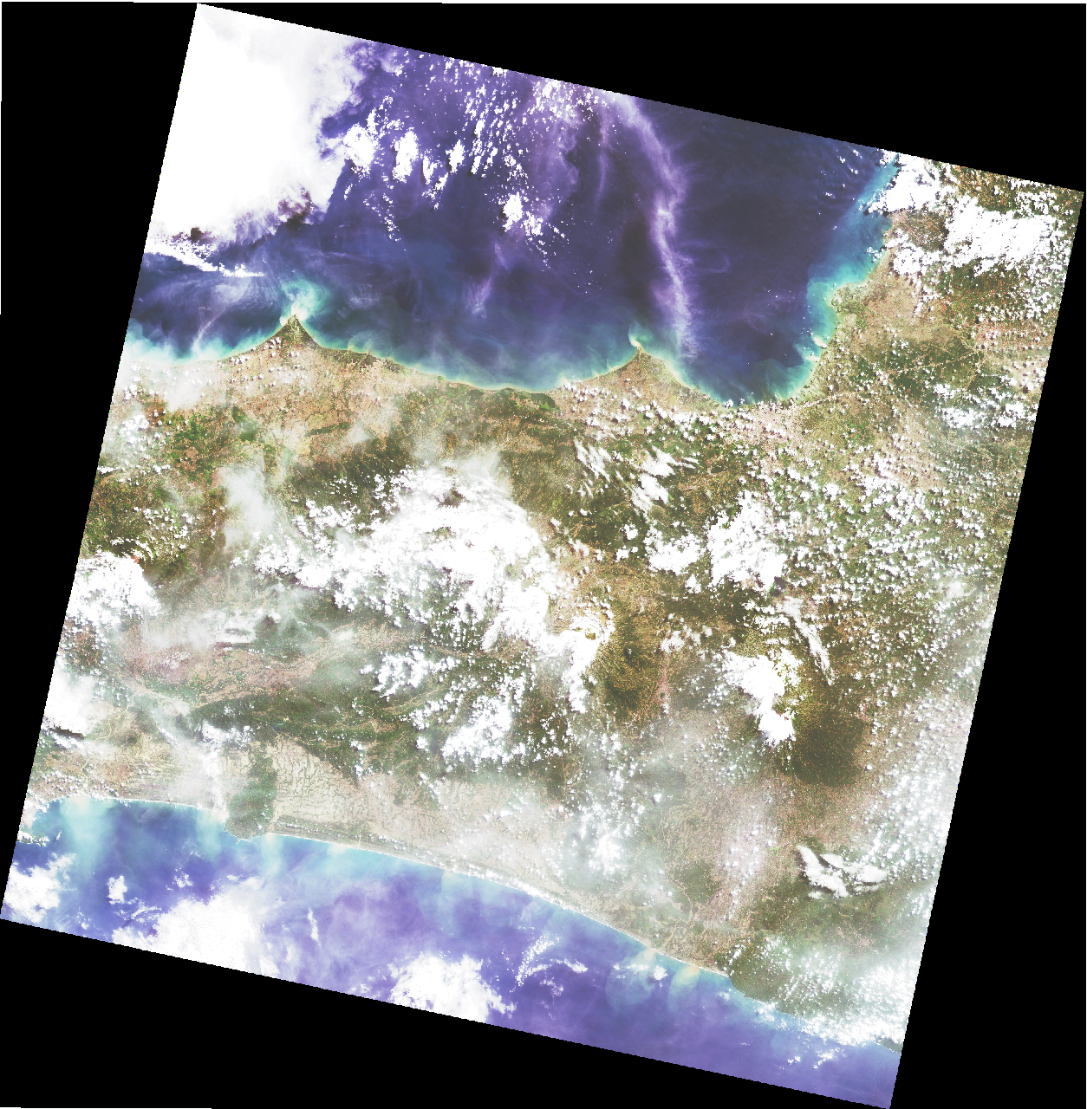
Cloud Masking
Band 432
Enhancement

Slide 3
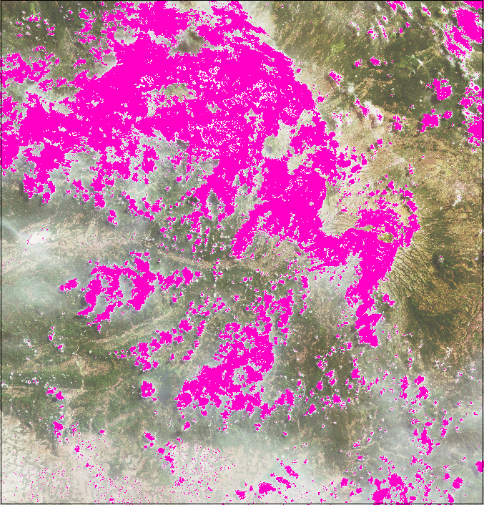
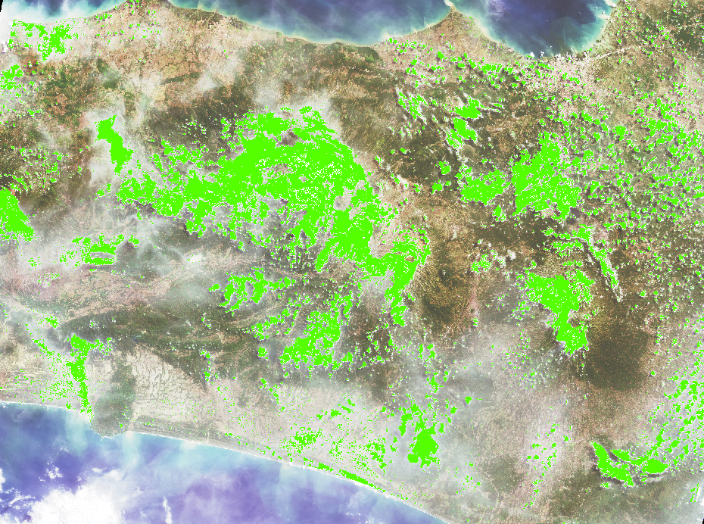
Band BQA

Slide 4
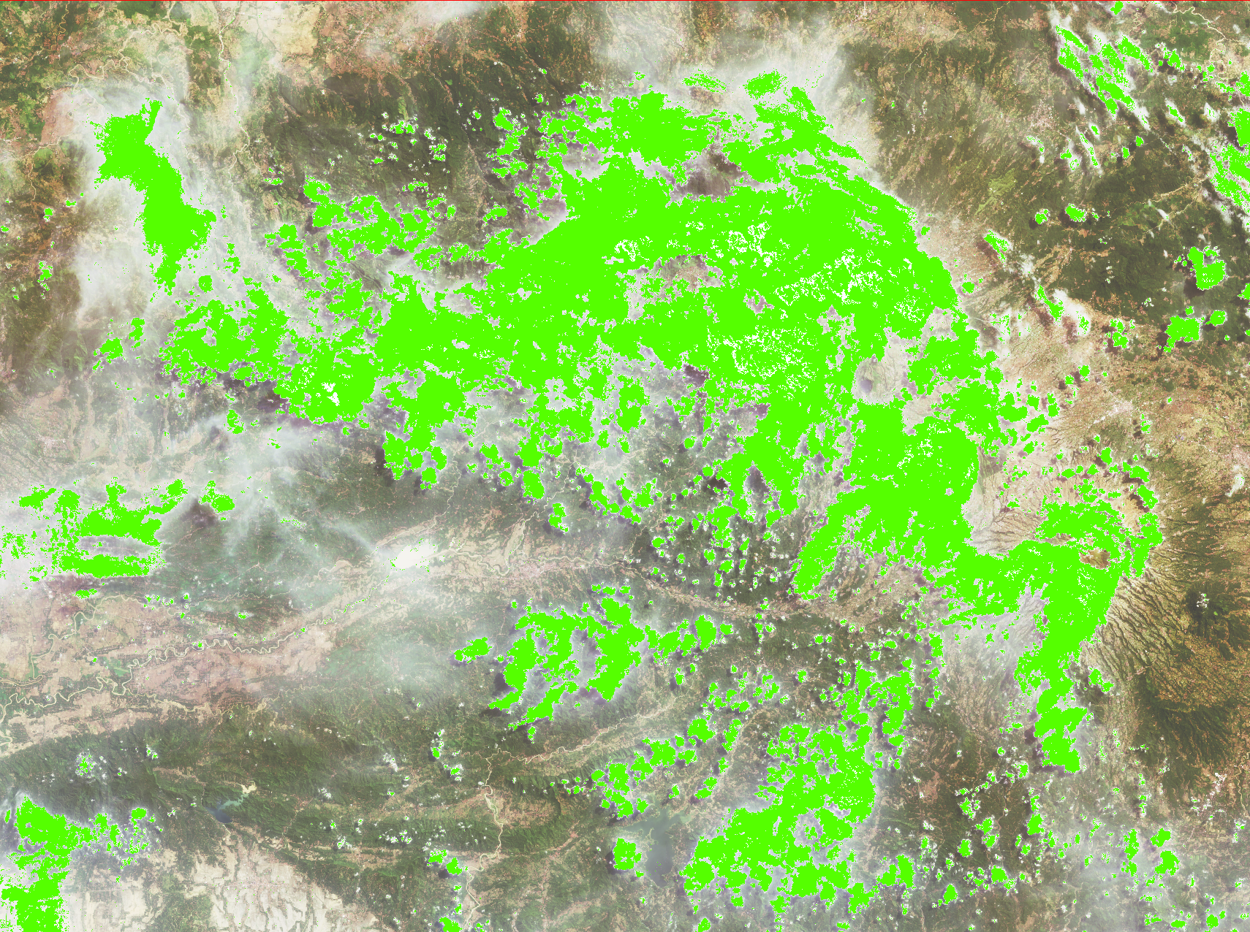
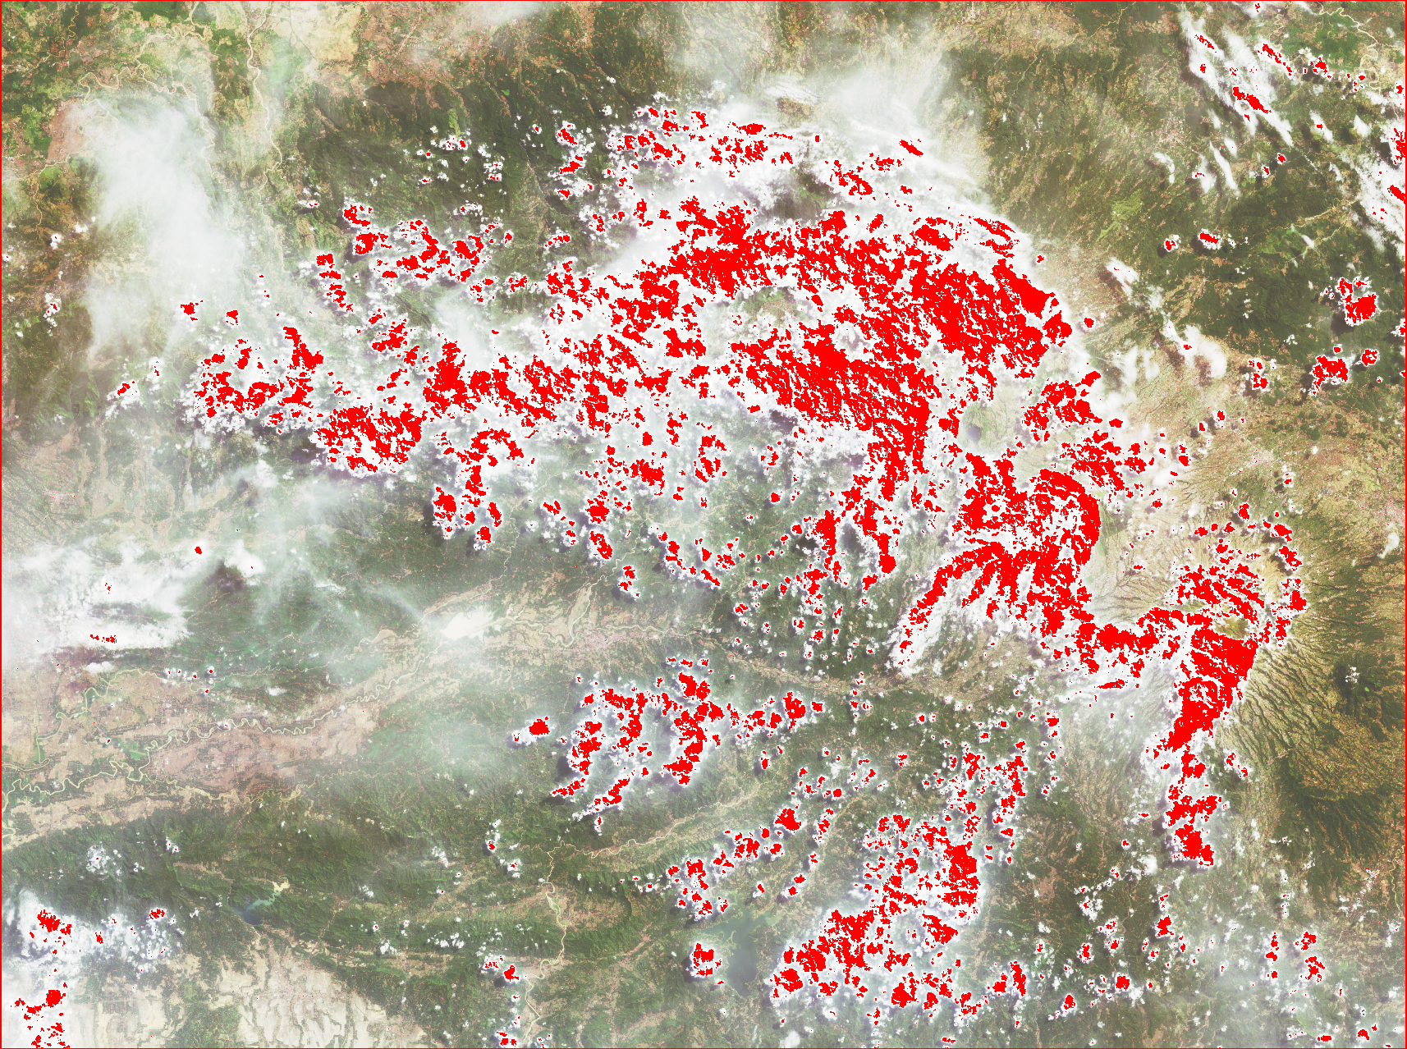
FMASK
BQA
FMASK

Slide 5
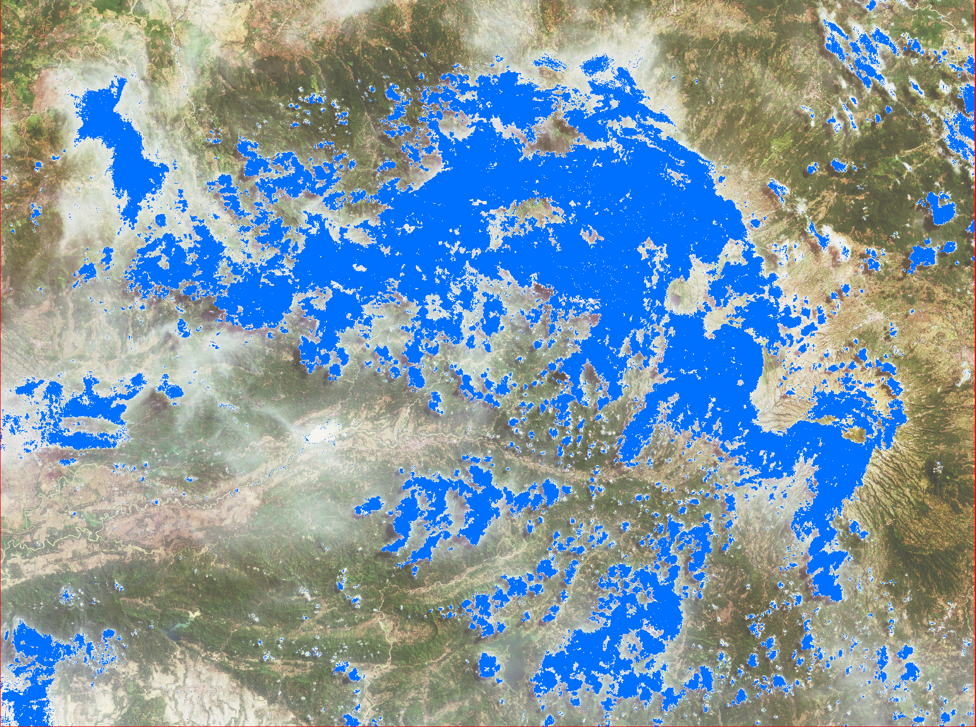
Combining FMASK & BQA

Slide 6
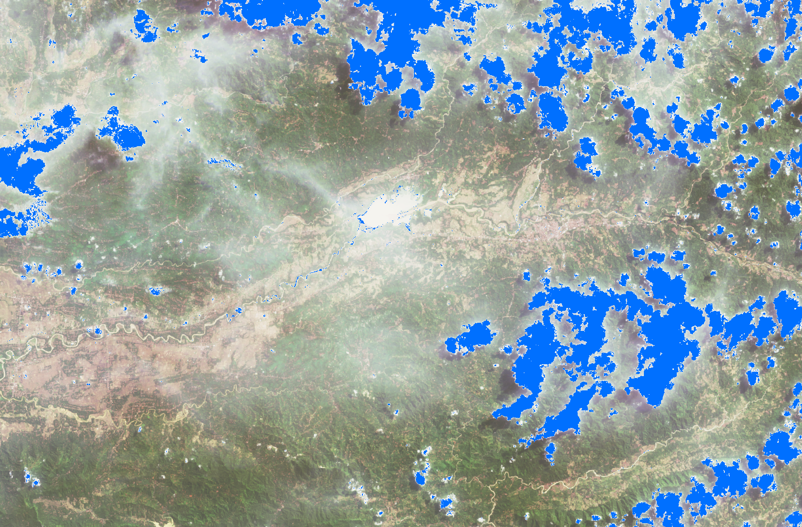
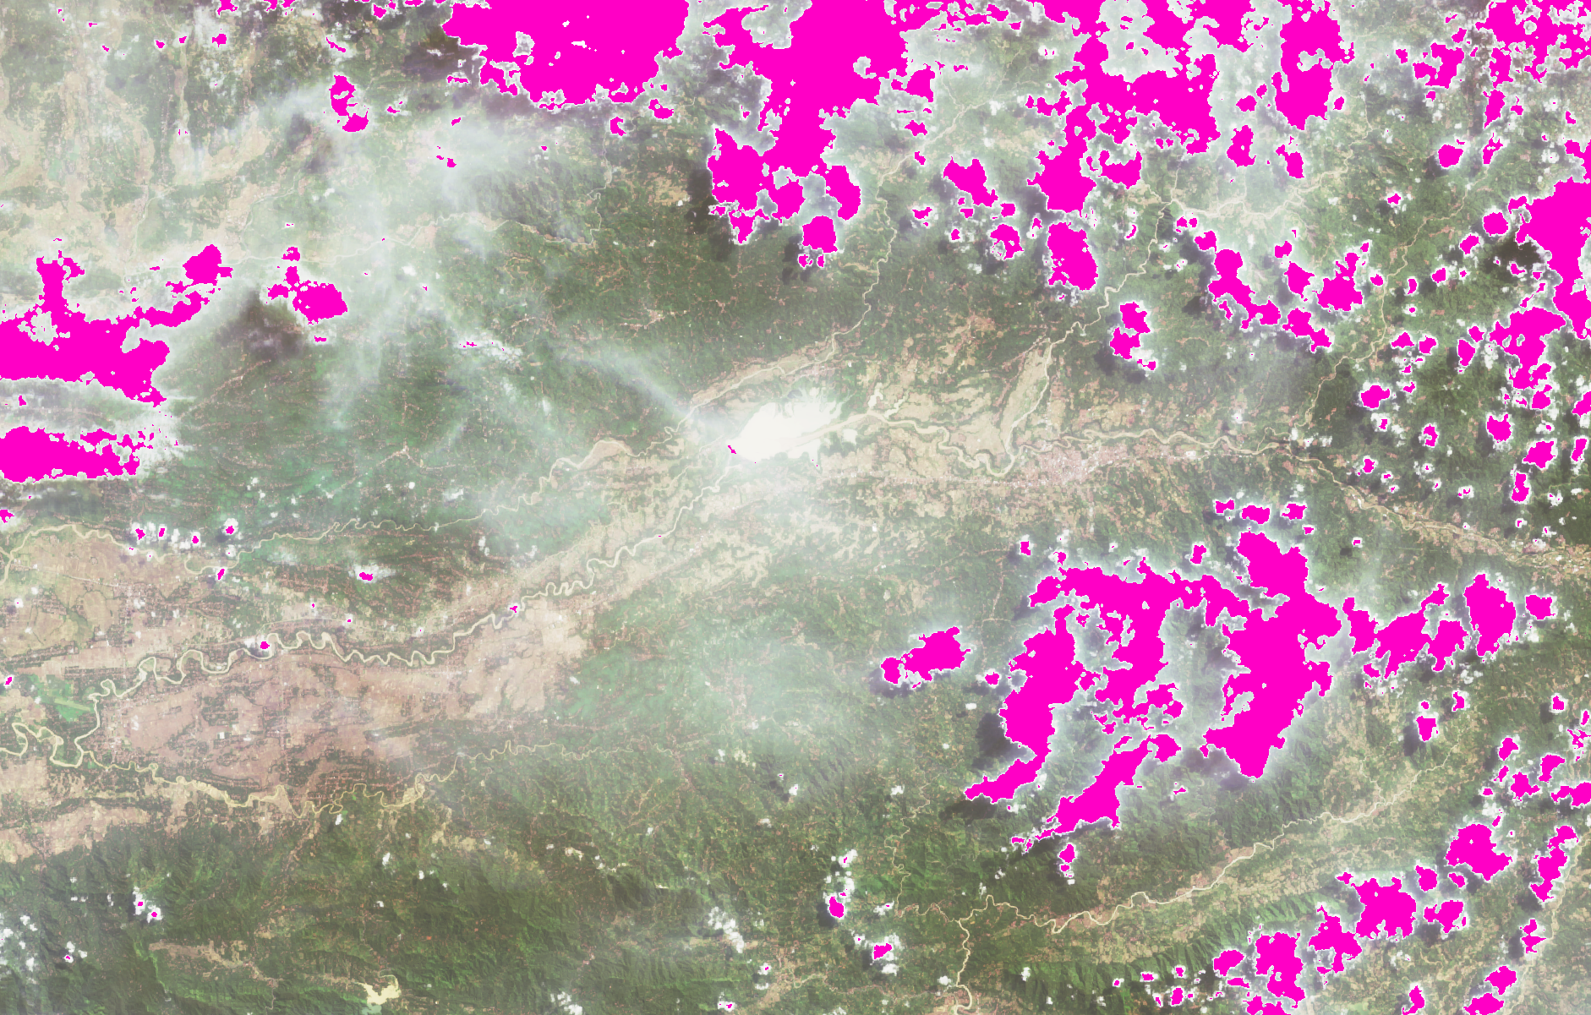
Cleaning
Original
After Cleaning

Slide 7
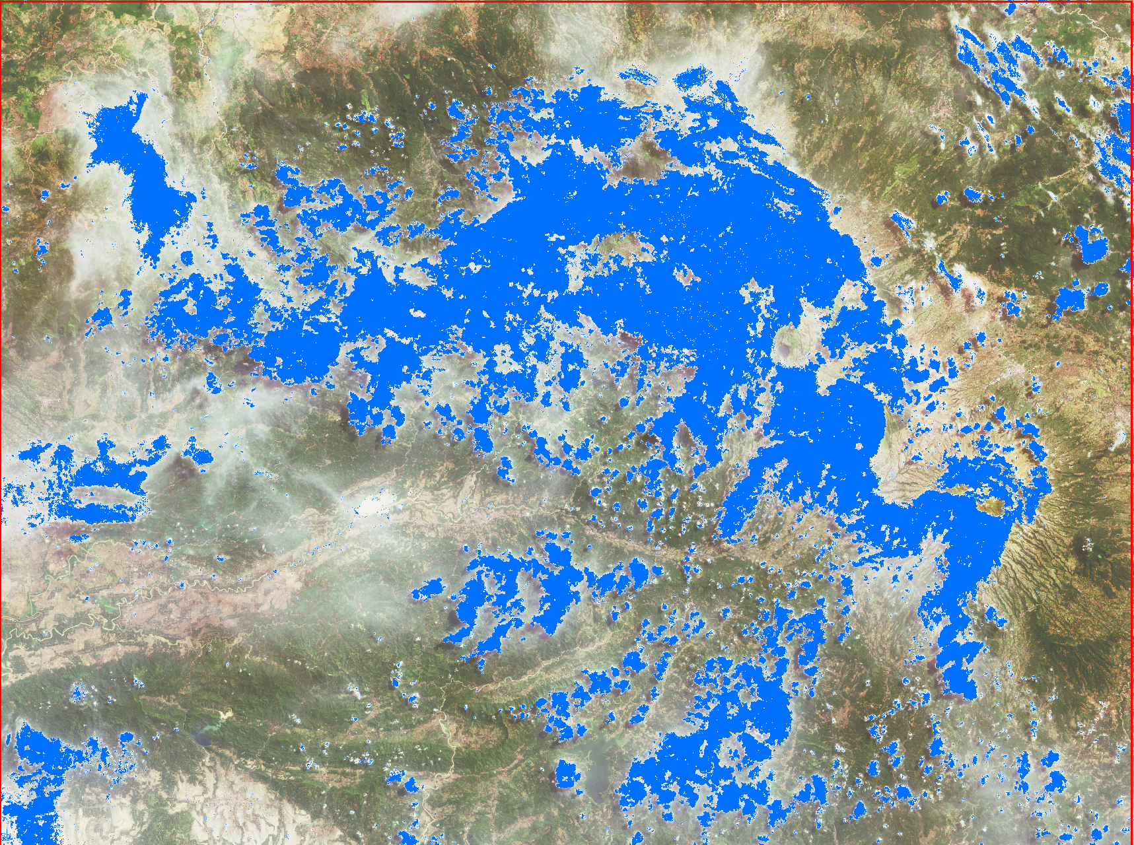
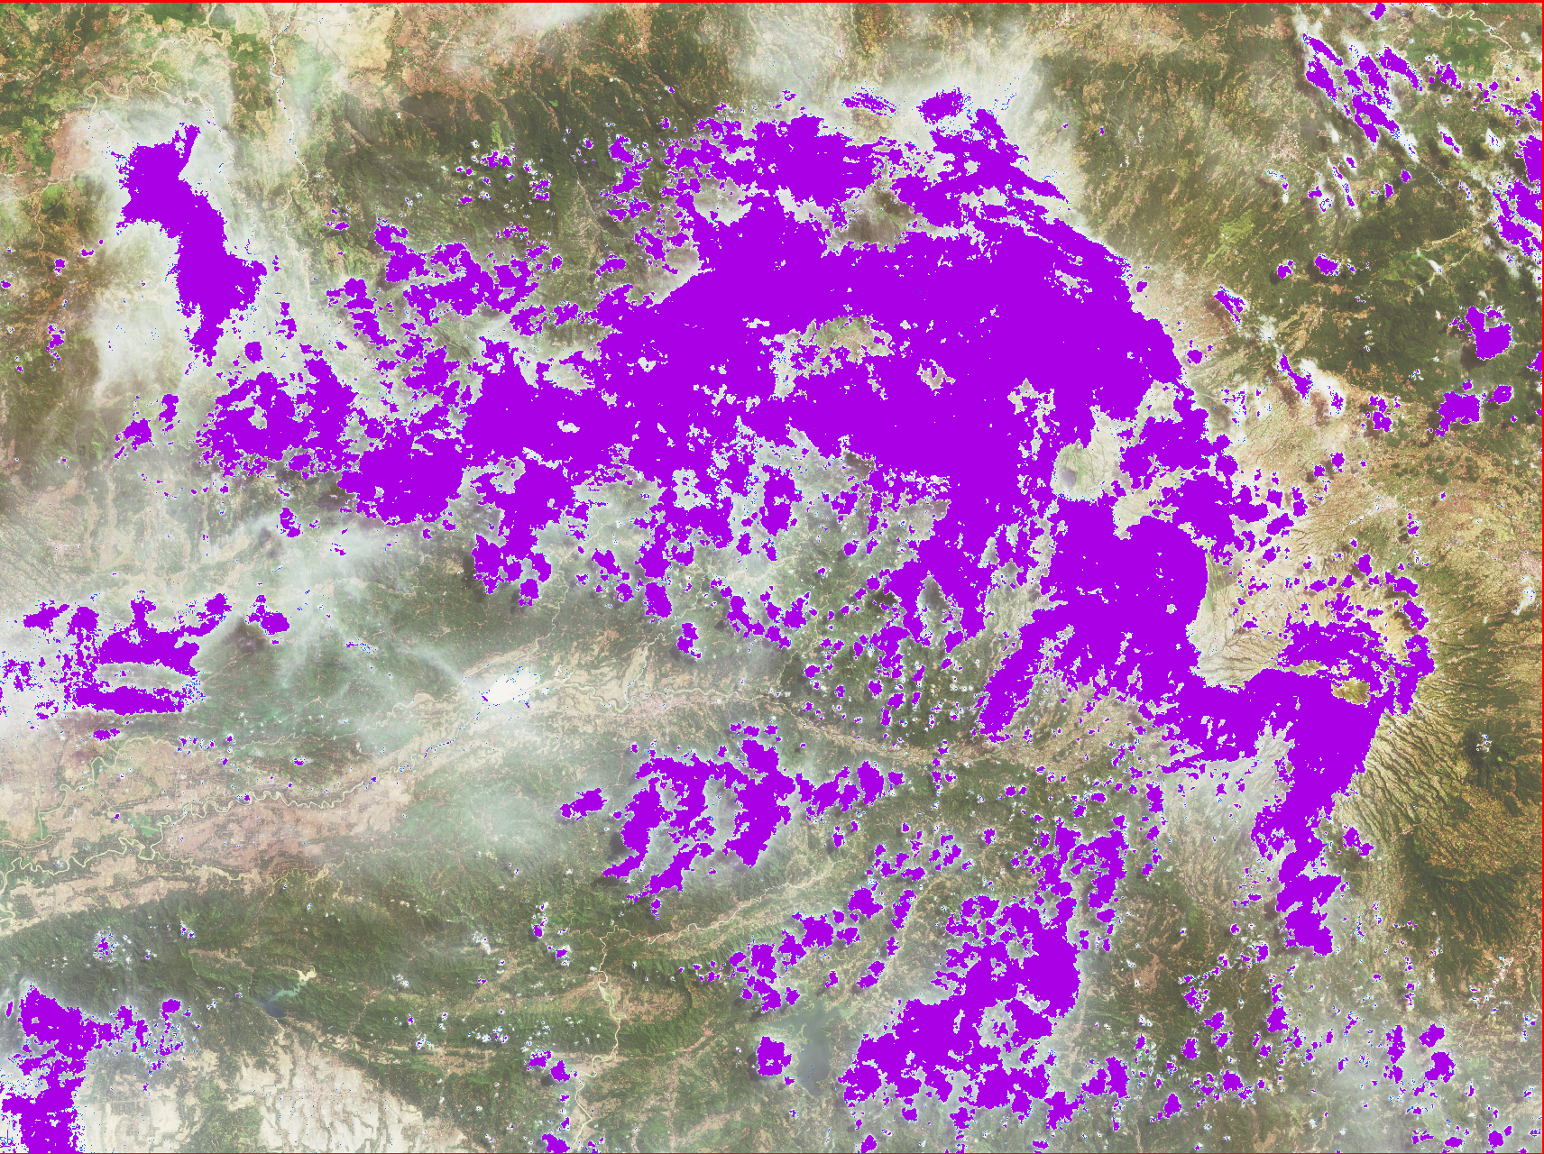
Median filter
BQA & FMASK
Median Filtering

Slide 8
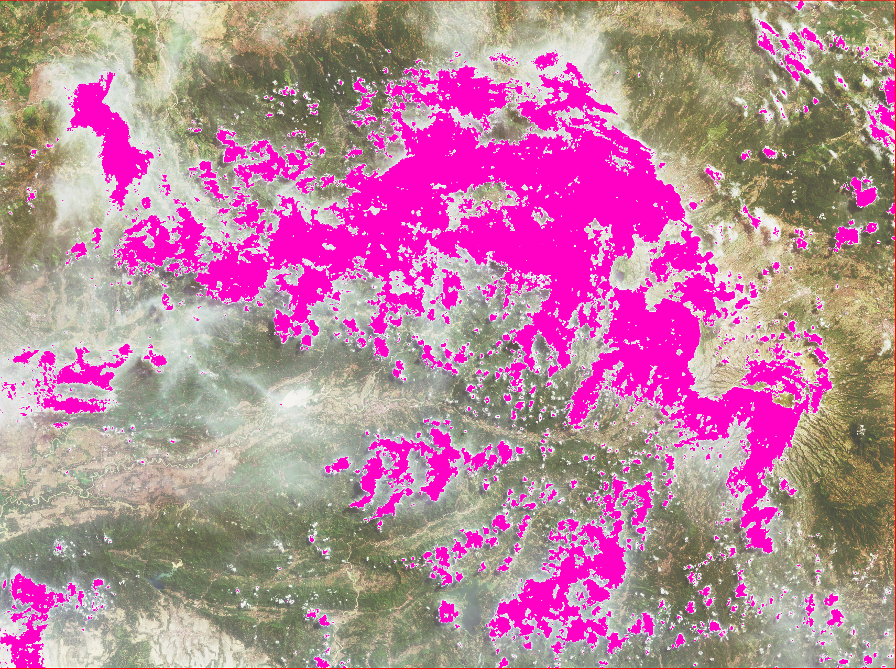
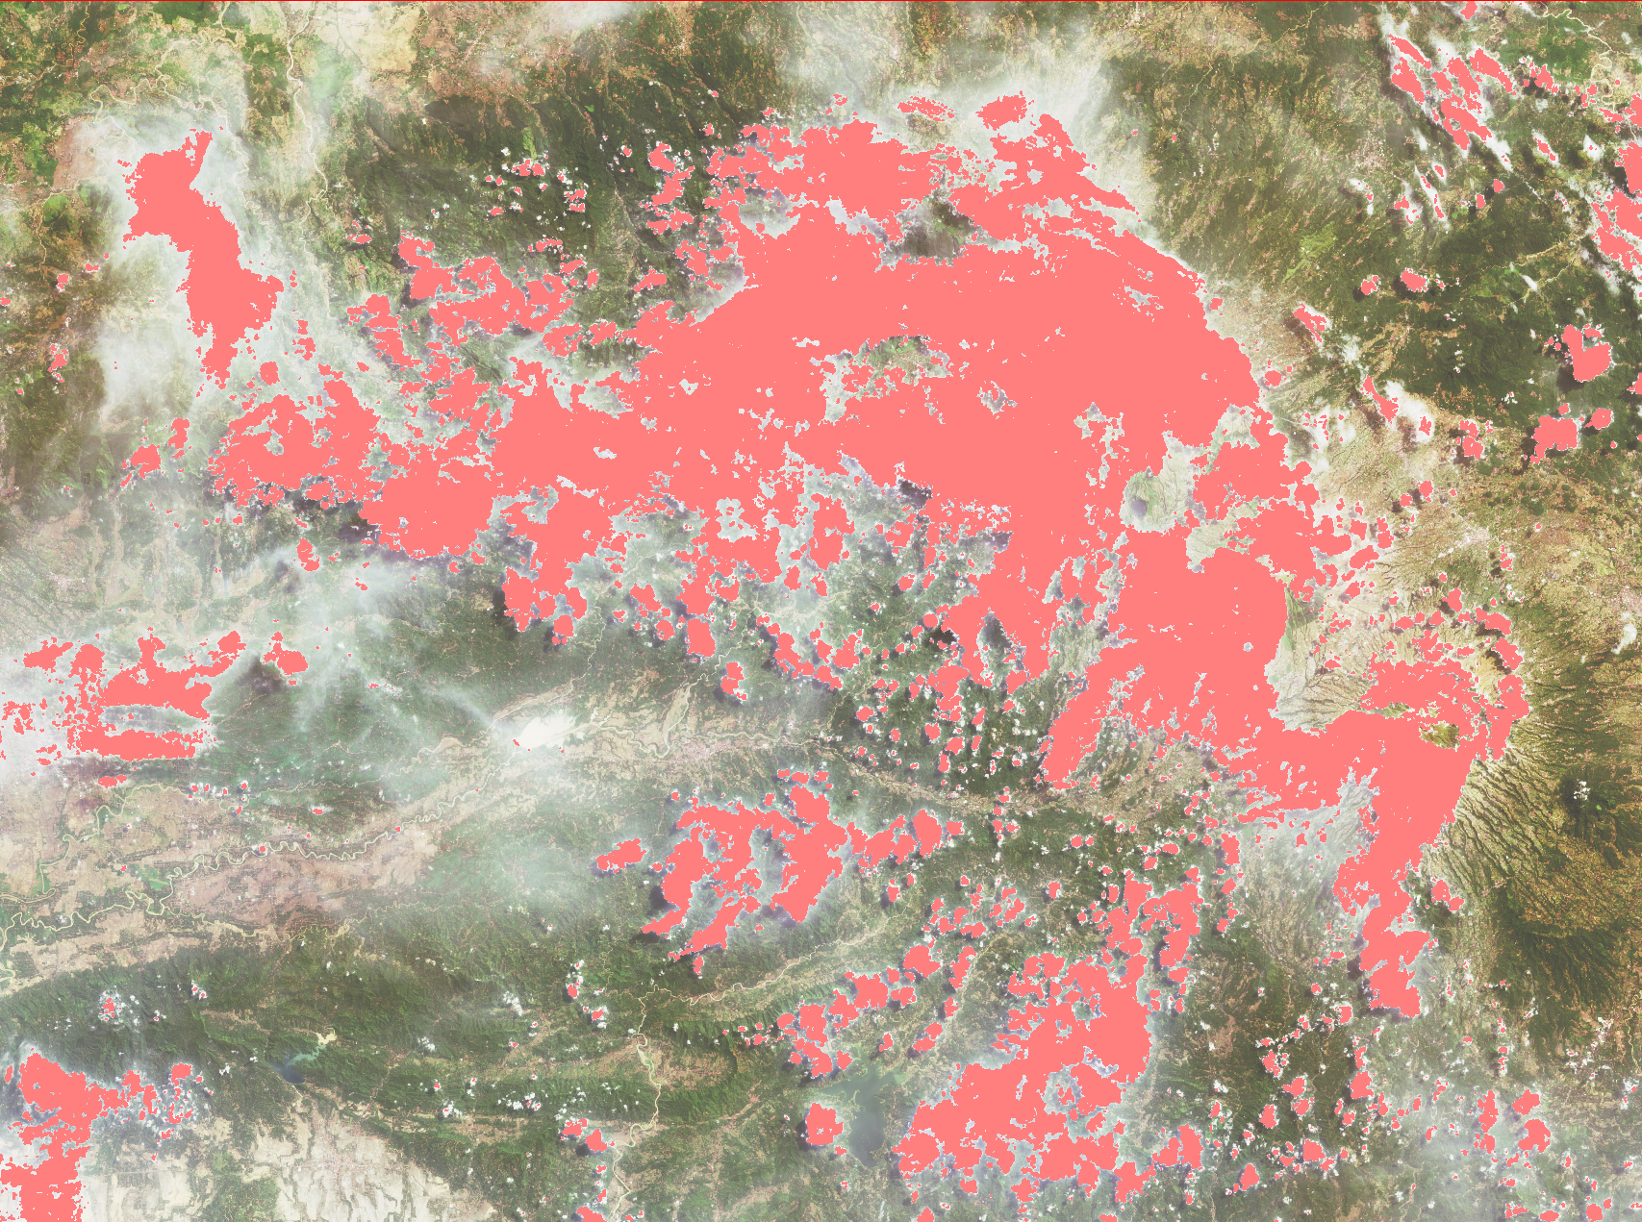
Buffering
Median Filtering
Buffering 2 pixels

Slide 9
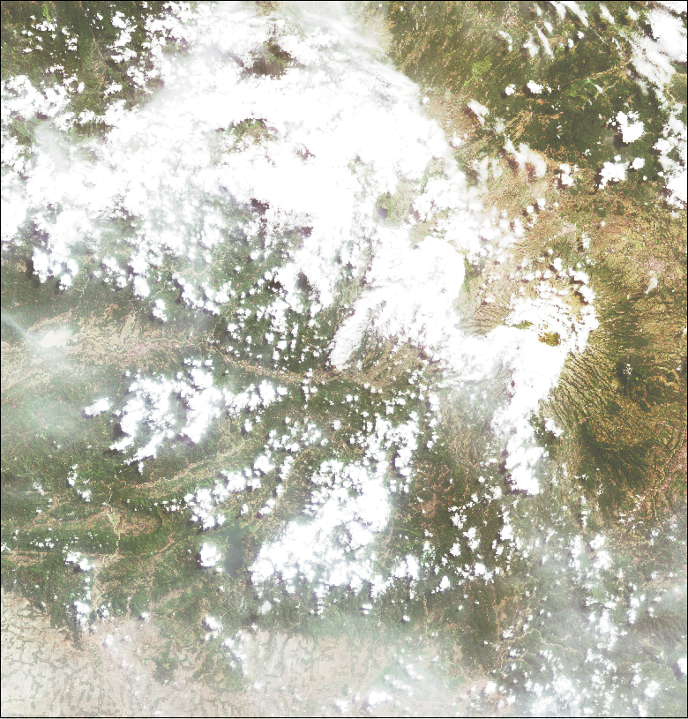
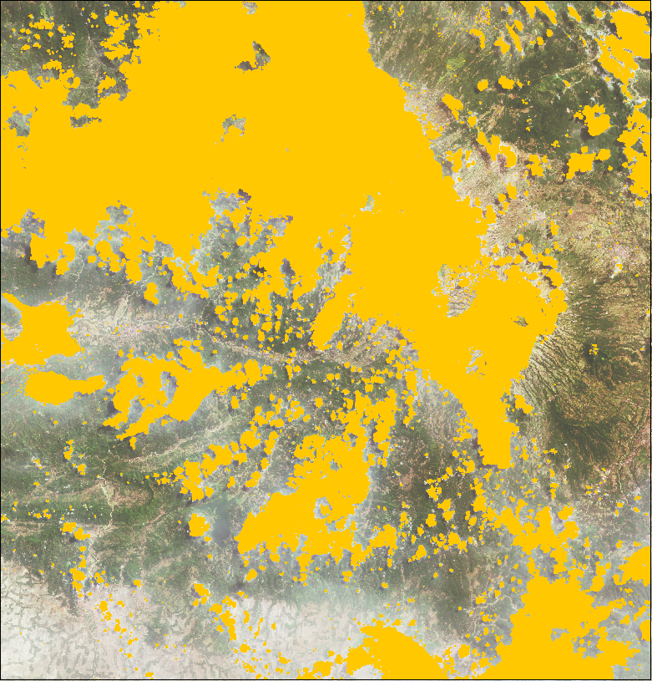
Normalized Difference Thermal Cloud Index (NDTCI)

Slide 10
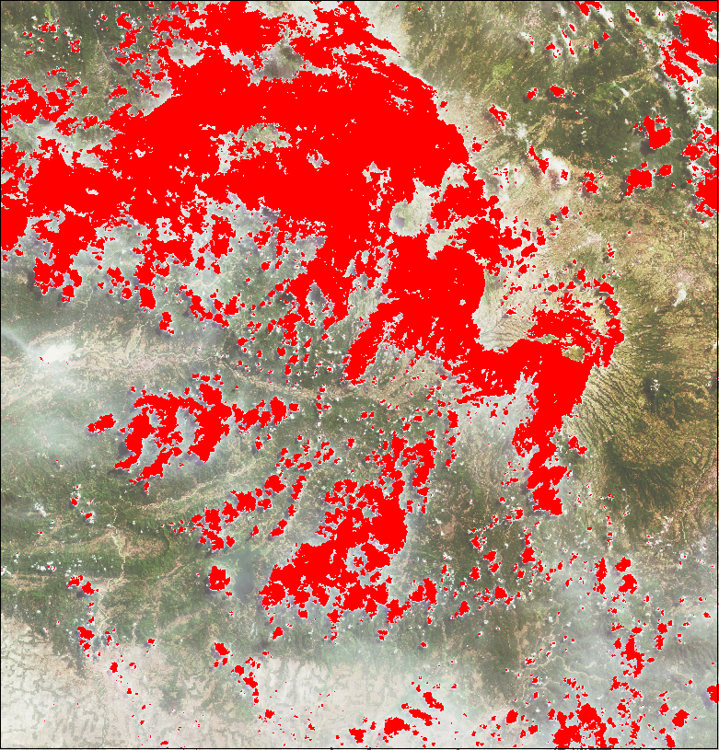
FMASK & BQA
NDTCI

Slide 11
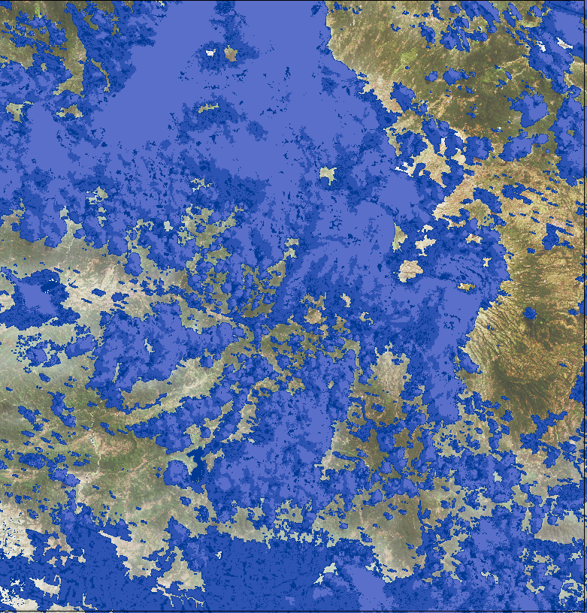
NDTCI
LAPAN
Notes:
Typically clouds are cold in the thermal region and have high reﬂectance in short wavelengths (blue). By calculating a normalized difference index between the two bands and thresholding a rough cloud mask can be obtained.

Slide 12
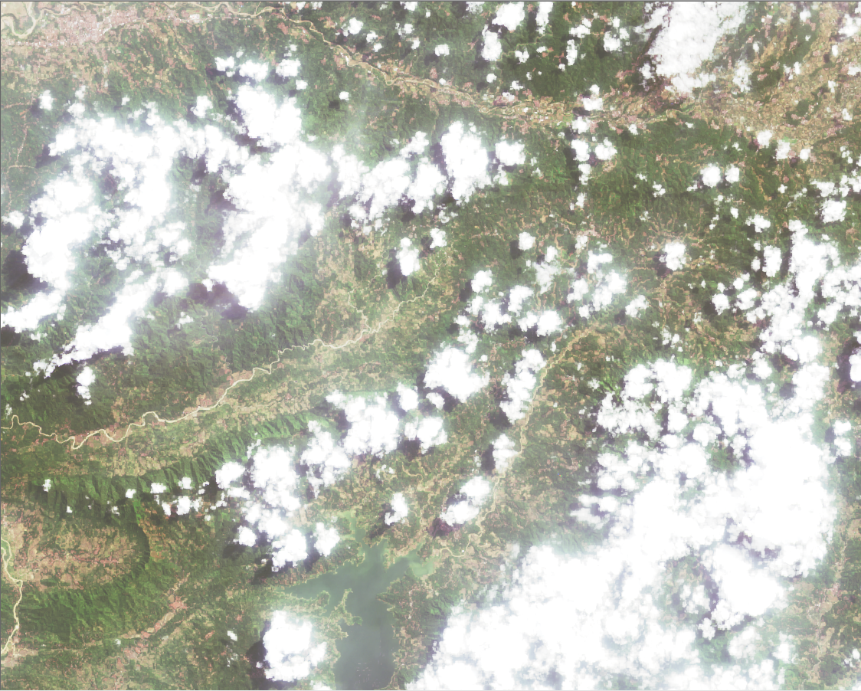
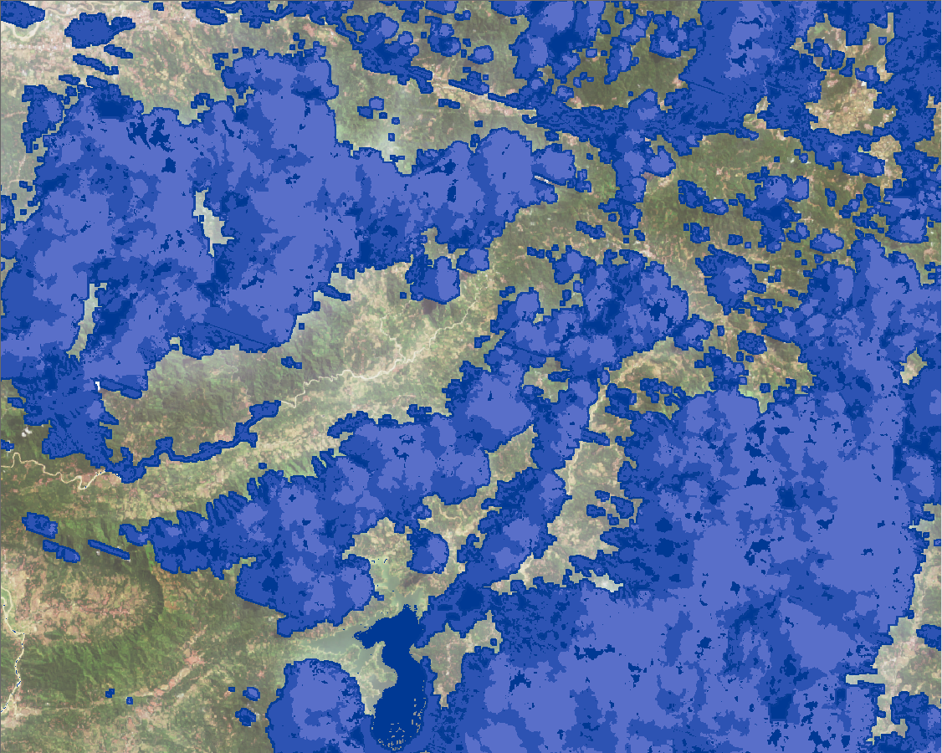
LAPAN’s Algorithm

Slide 13
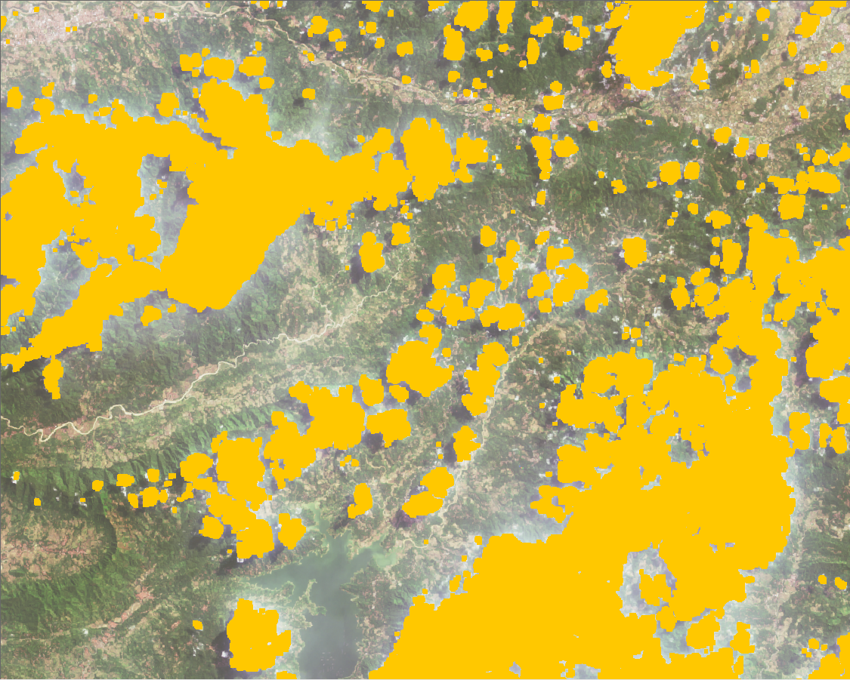
IPB’s Algorithm

